Slide 1
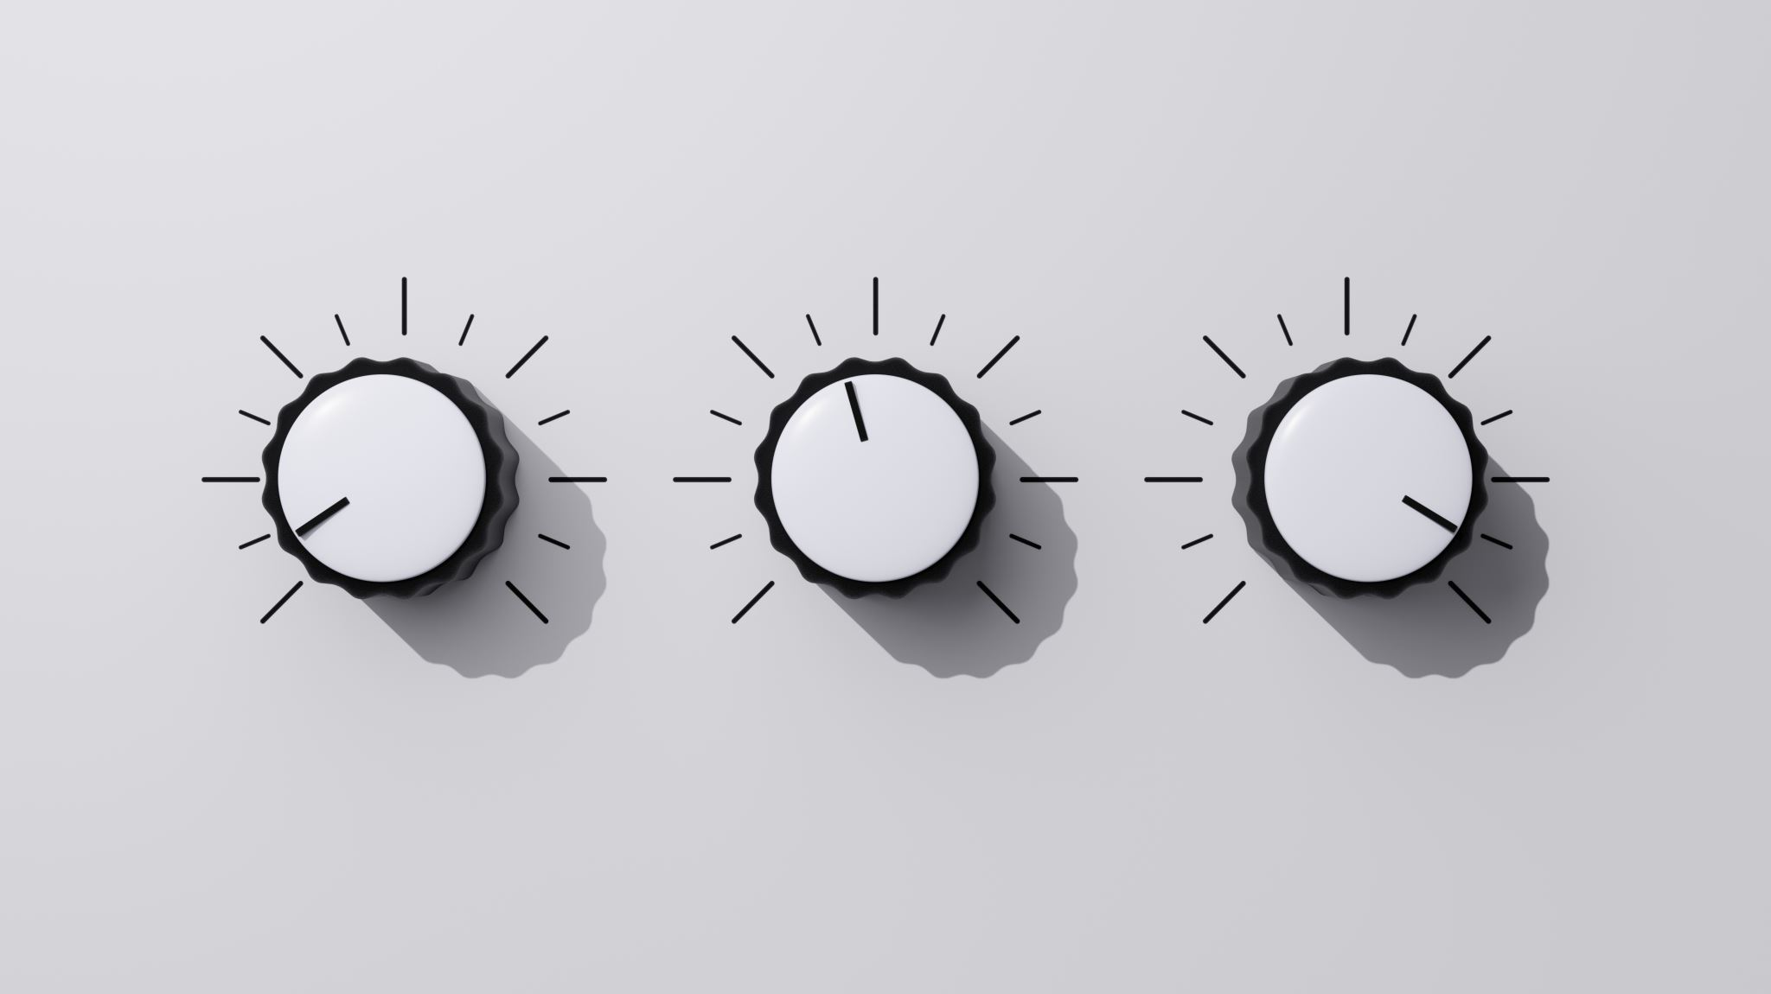
AUDIO SYNTHESIS

Slide 2
This guide is categorized into following sections: OSCILLATOR ENVELOPES TYPES OF SYNTHESIS FILTERS LFOs EFFECTS

Slide 3
OSCILLATOR Synthesizers are utilized to generate the sound. For generation it needs a generator of some sort, in many case are oscillator. The oscillator section of a synth generates waveforms at various amplitude and frequencies. Some of the basic wave shapes like sine wave, triangle wave, saw/sawtooth wave, square wave

Slide 4
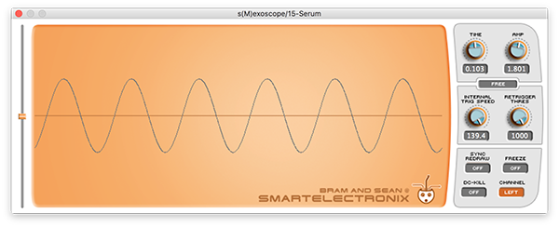
SINE WAVE 1. Sine waves, or sinusoidal waves, produce a soft, round, warm tone. 2. A pure sine wave will display a fundamental frequency and no overtones. 3. Smooth periodic oscillation is what characterizes a sine wave.

Slide 5
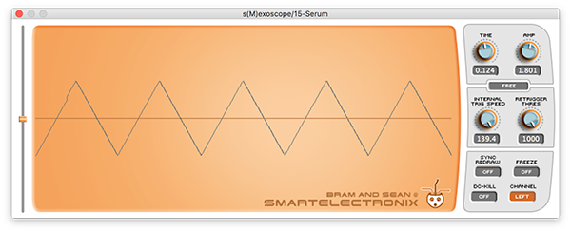
TRIANGLE WAVE 1. Triangle waves produce a tone that’s similar to sine waves, but that has some edge, and fuzz to it. 2. On a spectrum analyser, a pure triangle wave will display a fundamental frequency and only odd harmonics. 3. On an oscilloscope, a pure triangle wave looks similar to a sine wave, but it has pointed peaks and troughs.

Slide 6
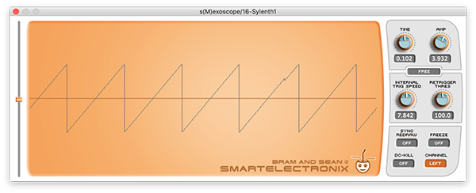
SAWTOOTH WAVE 1. Saw waves, or sawtooth waves, produce a tone that's “buzzy” and that sounds somewhat like a trumpet. 2. On a spectrum analyser, a pure saw wave will display a fundamental frequency with even and odd upper harmonics. 3. On an oscilloscope, a pure sawtooth wave typically ramps upwards from the bottom until it reaches the top, and then immediately returns to the bottom again.

Slide 7

SQUARE WAVE 1. It sound somewhat like a sawtooth wave, but significantly rounder, and fuller because of lesser presence of odd-order harmonics. 2.On a spectrum analyser, a pure square wave will display a fundamental frequency and predominantly odd harmonics 3. On an oscilloscope, a pure square wave will cycle between its peaks and troughs with little to no transition period.

Slide 8
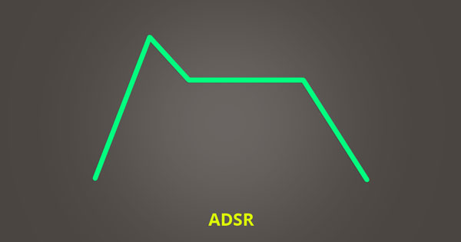
ENVELOPE A synth’s envelope section allows you to control amplitude over time. You can set various ADSR (attack, decay, sustain, and release) values to manipulate the amplitude envelope of a sound. ADSR can be visualized using a graph that plots amplitude over time. The amplitude of an envelope always starts at zero, rises to a maximum value, drops to a sustained level, and then returns back to zero; this process is controlled using various time values (attack, decay, release), and a single amplitude value (sustain).

Slide 9
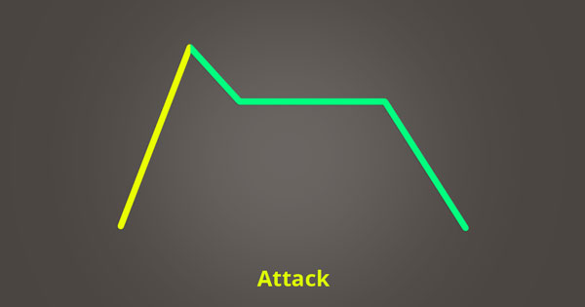
ATTACK
Attack time determines how long it takes the envelope to reach maximum amplitude.

Slide 10
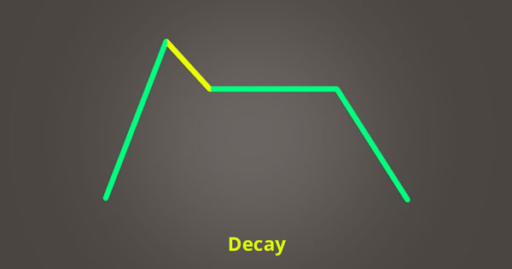
DECAY
Decay time determines how long it takes for the amplitude to transition from its maximum value to the level set with the sustain knob.

Slide 11
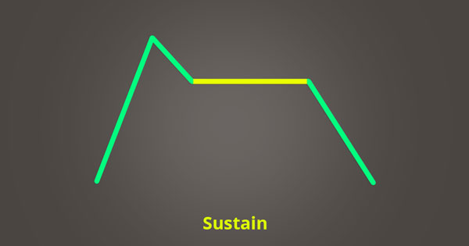
SUSTAIN
Sustain determines the level at which your amplitude will remain constant after it has attacked, and decayed.

Slide 12
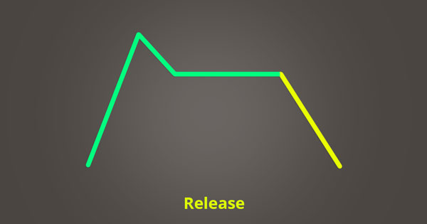
RELEASE
Release time determines how long it takes your sustained amplitude level to diminish to zero once you’ve stopped triggering your synth.

Slide 13
TYPES OF SYNTHESIS There are various different types of synthesis, and the type of synthesis used by a synth greatly effects the character of the sound it produces. These two are the most useful synthesis: ADDITIVE SYNTHESIS SUBTRACTIVE SYNTHESIS

Slide 14
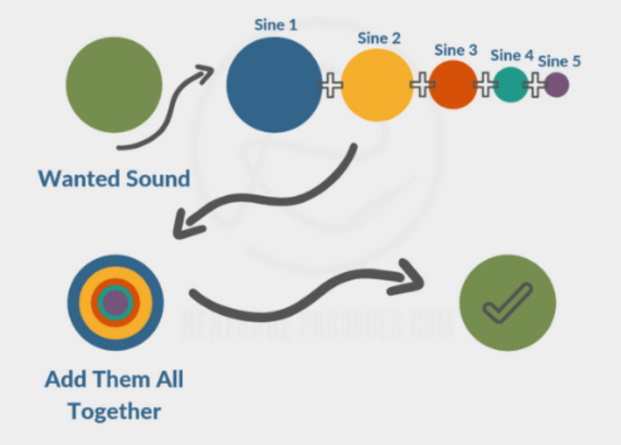
ADDITIVE SYNTHESIS With additive synthesis the sum of the output of two or more oscillators are used to create the desired synth sound.

Slide 15
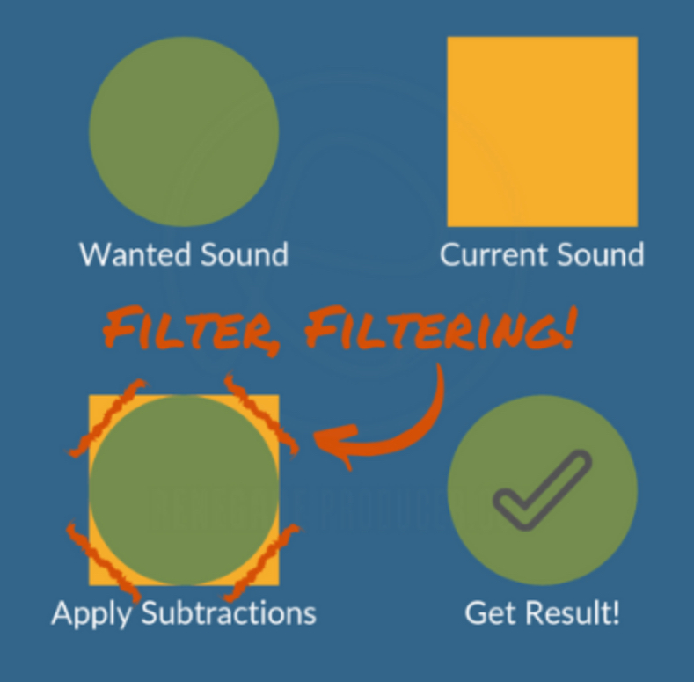
SUBTRACTIVE SYNTHESIS Subtractive synthesis is a method of audio synthesis is where you use filters to remove frequency content from, often harmonically rich, generated waveforms.

Slide 16
TYPES OF SYNTHESIS Other types of synthesis are: GRANULAR: It samples a sound source and split the samples into smaller pieces. FREQUENCY MODULATION: It uses a modulator frequency to change the timbre of a simple waveform. MODULAR: It modules to generate and process signal, modules can be connected together via patch cables. PHYSICAL MODELLING: It computes a waveform using a mathematical model(consists equations and algorithm). SAMPLE-BASED: It uses a form of synthesis that’s similar to subtractive synthesis. WAVETABLE: It create periodic waveforms. It is a bunch of waveforms squished together.

Slide 17
FILTERS The filter section of a synth cuts, or in some cases boosts the frequencies of the signal generated by your oscillators. Filters are a fundamental part of subtractive synthesis because they allow you to sculpt the character of your sound. Filters, as you probably know from the post on audio equalization, allow you to remove frequencies from an audio signal. Filters are useful in synths because it allows us to shape the sound generated by the oscillators to achieve the tone we want. The oscillators can create harmonically rich waveforms which you can then tame with the use of filters to produce the synth sound you want.

Slide 18
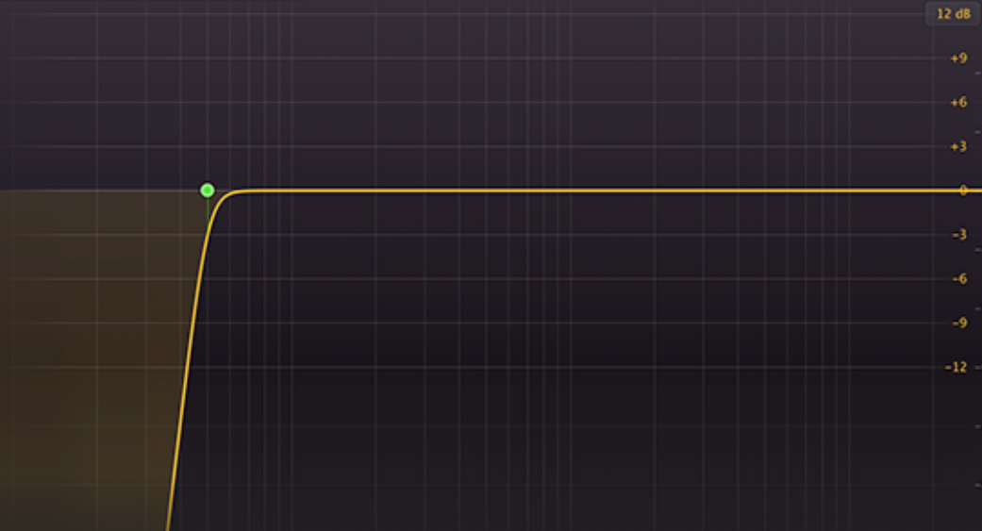
FILTERS HIGH PASS A high pass filter passes frequencies that are higher than the cut-off frequency and attenuates frequencies lower than the cut-off frequency. High pass filters are also sometimes referred to as low cut filters.

Slide 19
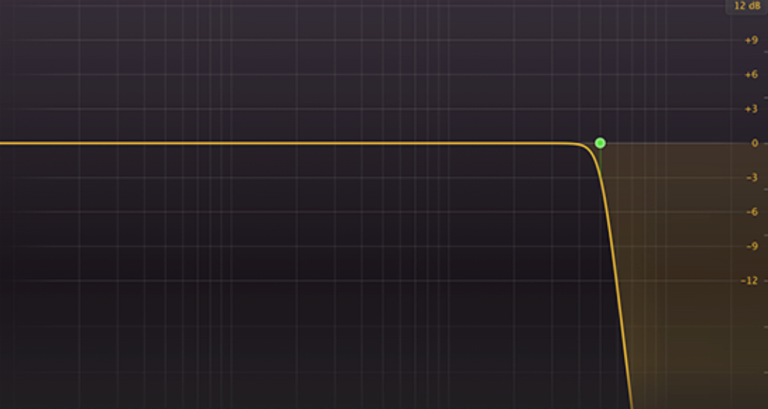
FILTERS LOW PASS A low pass filter passes frequencies that are lower than the cut-off frequency and attenuates frequencies higher than the cut-off frequency. Low pass filters are also sometimes referred to as high cut filters.

Slide 20
FILTERS BAND PASS: It passes frequencies within a certain range of its centre frequency and rejects (attenuates) frequencies outside that range. BELL: It boosts or attenuates frequencies within a certain range of its centre frequency. HIGH SHELF: It passes all frequencies, but increases or decreases frequencies below the shelf frequency by a specified amount. LOW SHELF: It passes all frequencies, but increases or decreases frequencies below the shelf frequency by a specified amount. NOTCH: A notch filter or band reject filter, rejects frequencies within a certain range of its centre frequency, and passes frequencies outside its range. TILT: It boosts frequencies above its centre frequency and attenuates frequencies below its centre frequency. It can also work oppositely and attenuate frequencies above its centre frequency and boost frequencies below its centre frequency.

Slide 21
LFOs The LFO (Low-Frequency Oscillator) section of a synth creates a rhythmic pulse or sweep that allows you to control the synth's parameters over time. LFOs can be applied to parameters in Serum the same way that an envelope can, but the difference is that an LFO isn’t based on ADSR. An LFO will continuously effect the parameter it's mapped to, and modulate the parameter based on the shape and rate of the LFO. Typical LFO shapes include sine waves, triangle waves, saw waves, or pulse waves. However, Serum allows you to make custom LFO shapes, which means you aren’t limited in your modulation options. An LFO is typically used to apply audio effects like vibrato, tremolo, and phasing to your audio signal. If you wanted a filter to open and close every quarter note, you could program Serum to do so using an LFO. LFOs are great for adding texture to your patches and are an excellent way to make your synths come to life.

Slide 22
EFFECTS Synths often come loaded with some effects that you can add into your signal path. Common types of effects include. CHORUSES COMPRESSORS DELAY DISTORTION Eqs PHASERS REVERBS

Slide 23
REFRENCES
https://www.blackghostaudio.com/blog/the-beginners-guide-to-audio-synthesis
https://www.renegadeproducer.com/audio-synthesis.html
https://youtube.com/playlist?list=PLrnjie9klQEkZGar3zZ4hRurU_kUDk7Md
https://youtu.be/OVdwspf0epY

